Slide 1




More Clear than Mud: Using Os to Unravel Sources of Fe to Seawater through the Cenozoic
Logan Tegler^{1,2, 3}
Arizona NASA Space Grant Symposium
2017-2018
Mentors:
Dr. Ariel Anbar^{1,2}, Dr. Stephen Romaniello¹, Dr. Tristan Horner³ and Dr. Ann Dunlea³
Notes:
Hi I’m Logan and I’m a senior undergraduate who’s been working in Ariel’s lab for the last three years. I’ve been lucky enough to work on several projects with him. Today I’ll be talking about the work I did for my senior thesis. This work with done in conjunction with the NIRVANA lab at Woods Hole Oceanographic Institution, which is where I’ll be attending graduate school next year.

Slide 2
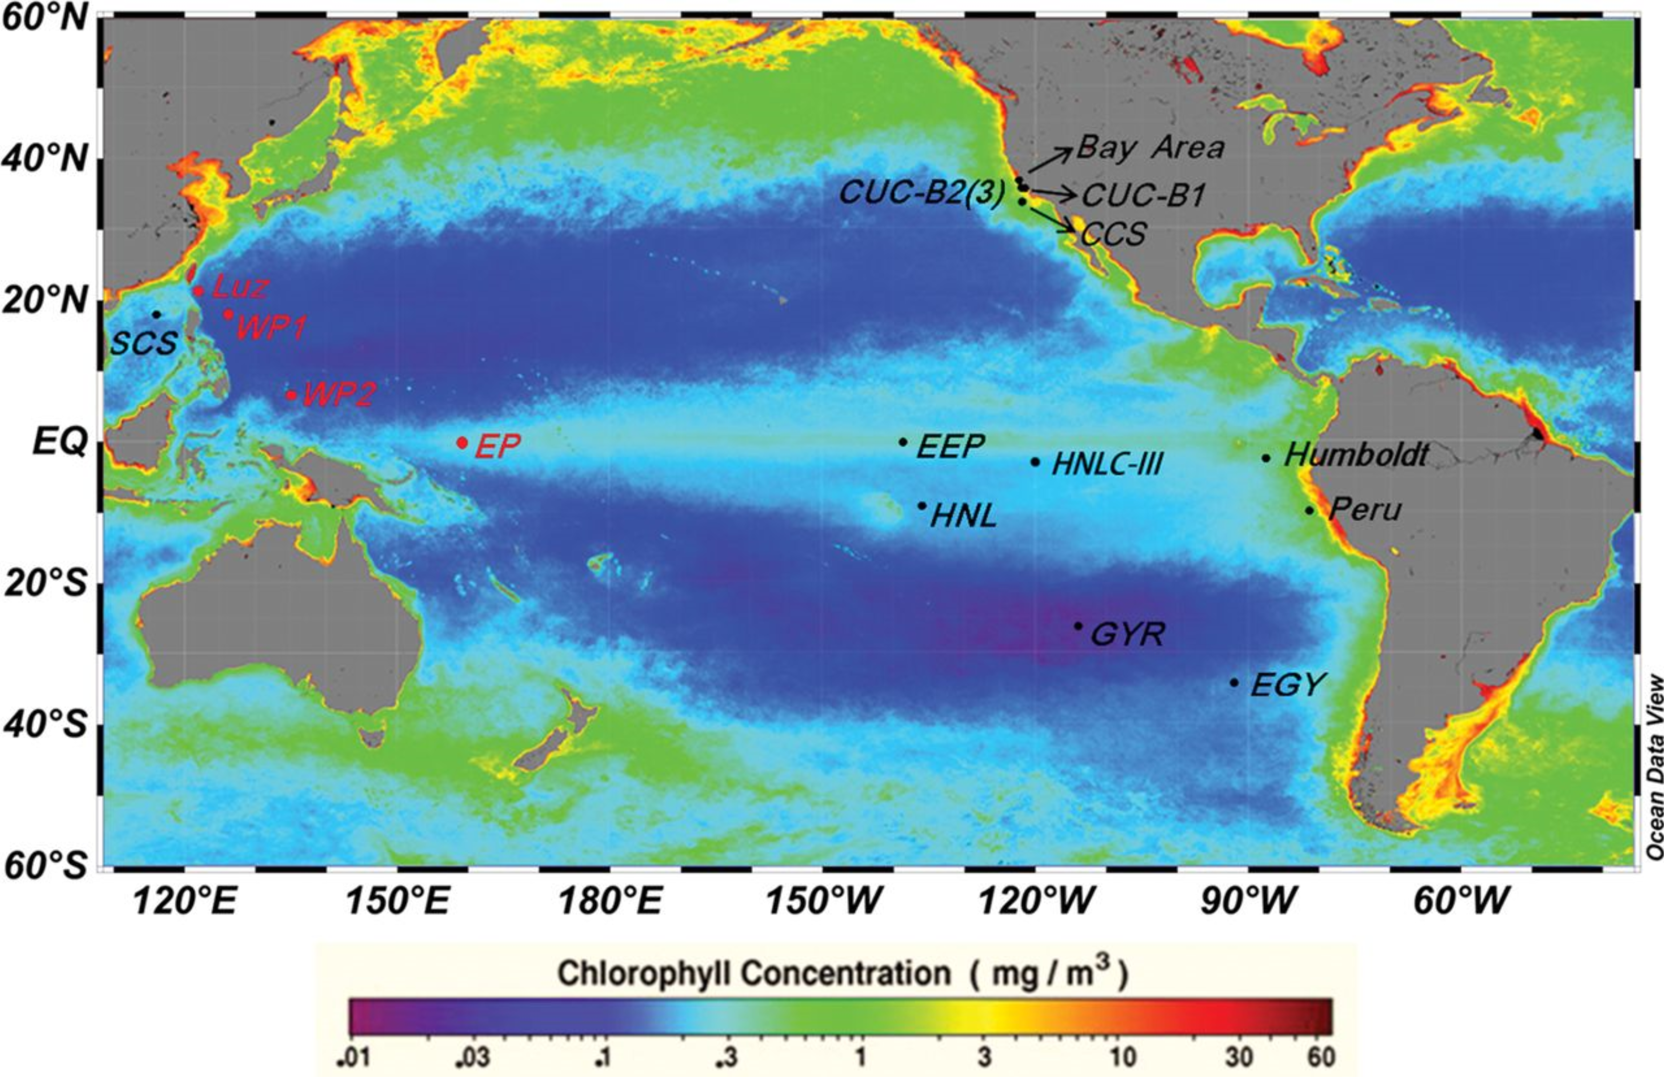
Primary Productivity and Fe Limitation
Phytoplankton draws down a considerable amount of atmospheric CO₂ and plays a role in modulating climate
However, primary productivity is limited by Fe bioavailability in high-nutrient low-chlorophyll (HPLC) regions
(Li et al. 2015; J. Plankton Research)
Notes:
So I want to start my motivating my work.
Primary productivity accounts for about ½ of global photosynthesis and is a major sink of CO2 and is closely linked to Earth’s carbon cycle. Modern studies show that iron (Fe) is a limiting micronutrient for primary productivity in high-nutrient low-chlorophyll (HNLC) regions. (In this figure you see the Southern Ocean. The key below highlights the chlorophyll concentrations, where cholorphyll is a measure of primary productivity. The dark blue indicates regions that have low chlorophyll concentrations while the red indicates higher concentrations. In this part of the ocean, there is little primary productivity.). So, our goal is to understanding the sources and cycling of over time to better understand patterns of global climate change.
I’ll begin by motivating my work. Primary productivity in the ocean acts as a major sink of atmospheric carbon, and therefore plays a major role in modulating climate. However, in some ocean regions, productivity is limited. In the figure to the left, we see an ocean section with a color gradient that should chorlophyll concentration, which is a measure of productivity. The areas in blue are defined by low productivity. These regions, call high-nutrient low-chlorophyll regions, are critically limited by the micronutrient Fe. Therefore, in order to understand global climate shifts, past and present, it is important to consider the sources and cycling of Fe over time.

Slide 3
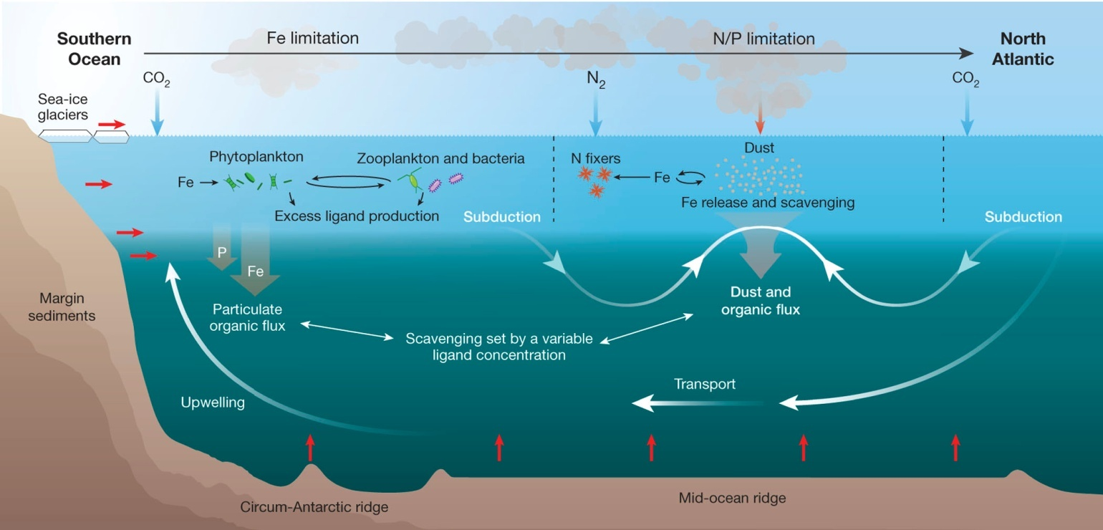
Fe: A Complex System
Aerosol Sources
Hydrothermal Sources
Sedimentary Sources
(Tagliabue et al. 2017; Nature)
Notes:
However, understanding Fe cycling is quite complex, as shown by this figure. However, I would like to highlight two portions of this figure
Sources of Fe. There are three sources of Fe—name them
2. Once these sources of Fe enter the water column, they go through subduction, transport, and upwelling. This results in a mixing of the Fe sources. But if we want to really understand the importance and variation of Fe sources over time, we have to find a way to tease apart these sources. We can do this using isotopic analysis.
Cycling of Fe
Biological pump, geological changes over time
In this study, I’ll be more focused on teasing about the sources of Fe.
The figure highlights three sources of Fe
Hydrothermal sources, aerosol sources, and sedimentary sources
But, in seawater, how can we tell these sources apart?
Isotopes!

Slide 4
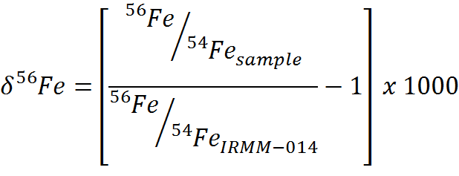
Isotopic Fingerprinting
56
56
56
54
54
54
56
56
54
54
Enriched with ⁵⁴Fe
Notes:
For the most part, most of us ignore isotopes because they generally participate in reactions at the same rates. However, some processes will cause what we call “isotopic fractionation”. These processes are unique, and often leave behind a characteristic signature that we can track back to the source. To illustrate consider the following reaction:
Some source material starts out a known amount of 56/54Fe ratio. But, a chemical process occurs that prefers 54Fe. So, after the reaction, the product is “enriched with 54Fe” and the ratio of 54/56 is smaller than it was originally.
We can measure these changes with mass spectrometers, and if we know the isotopic signatures of a source, we can effectively “fingerprint” the sample to determine where it cam from.
Because these variations in isotope abundances are small, we usually report these variations in what we call delta notation, where we normalize the measured isotopic ratio to that of a standard reference material and multiple by a thousand. This means that we’re talking about part-per-thousand or “permil” variations in isotopic abundances.

Slide 5
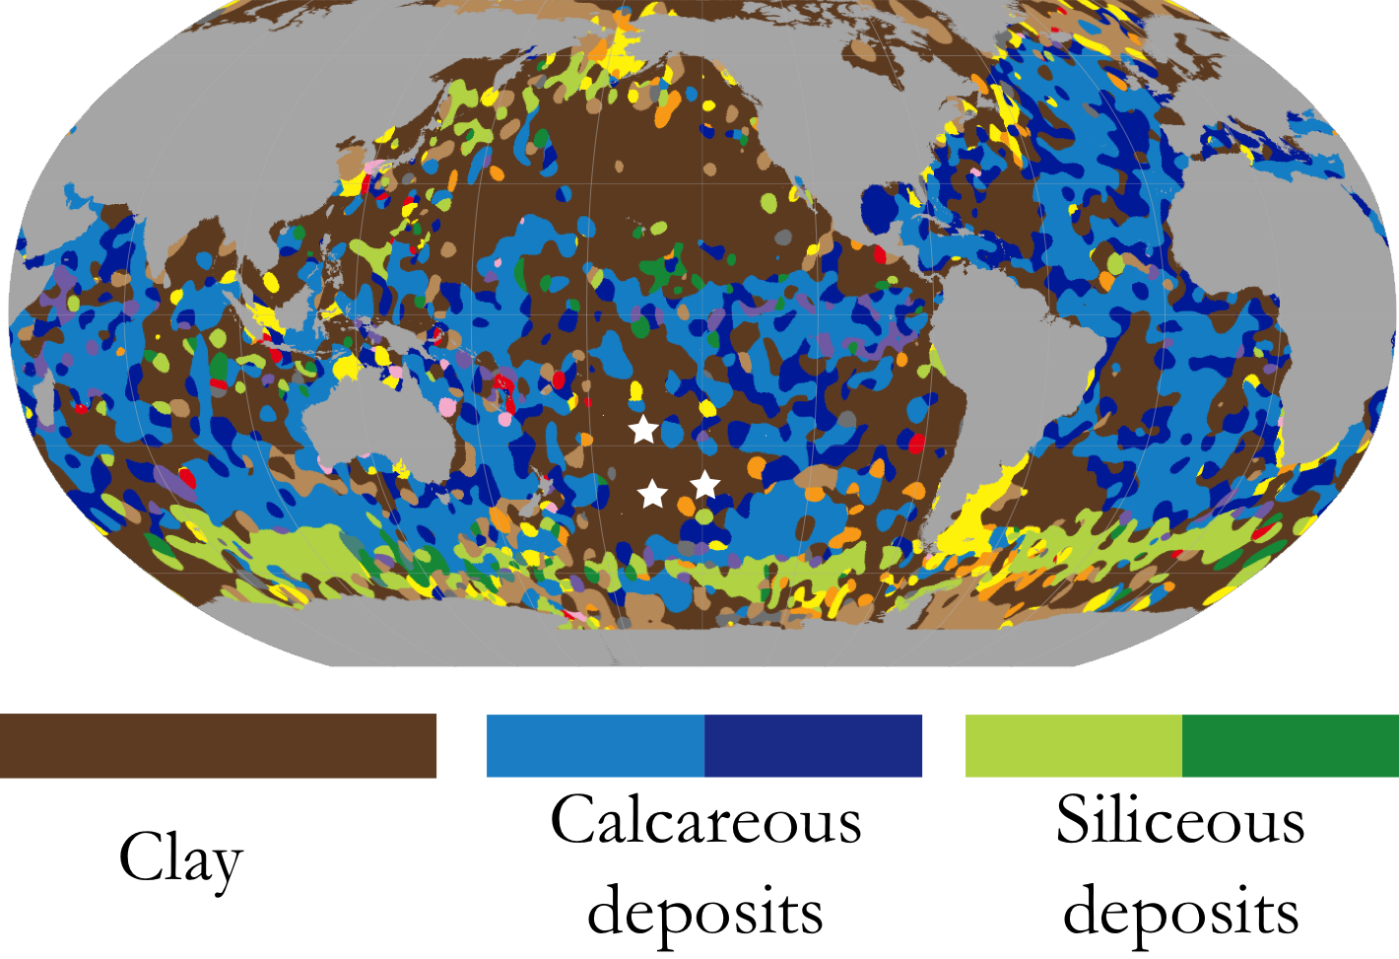
Pelagic Clays as a Potential Archive
(Modified from Dutkiewicz et al. 2015; Geology)
Notes:
There have been many studies that have looked at Fe isotopic values, but they have failed to give good spatial and temporal coverage. So, in this study, I proposed using a different kind of sediment to trace Fe though time.
Pelagic clays, the brown portion of this global map, cover ~50% of the seafloor and have records that can go back to 100Ma. Our three core sites are highlighted by the large star. If we can capitalize on these clays, it could be instrumental to reconstructing sources of Fe to ocean.

Slide 6
Pelagic Clays as a Potential Archive
Pelagic clays cover ~50% of the seafloor
Some clays are heavily enriched with Fe (up to 80 wt.%)
Pelagic clays are made up of six components
Here, we focus on Site U1366, with plans to expand the study to Sites U1369 and U1370
Depth (mbsf)
(Dunlea et al. 2015; Paleoceanogr.)
Notes:
As I mentioned, these clays cover a significant portion of the seafloor. They can also be substantially enriched in Fe.
However, despite their potential, these clays haven’t been exploited for two reasons
1. They are made up of 6 components, but only the Fe-Mn contains the isotopic signatures that we need. That means we have to develop a separation technique.
2. They have different sedimentation dates so they are very difficult to date accurately. (It’s very difficult to reconstruct sources of Fe if you don’t know when the change was occurring!)

Slide 7
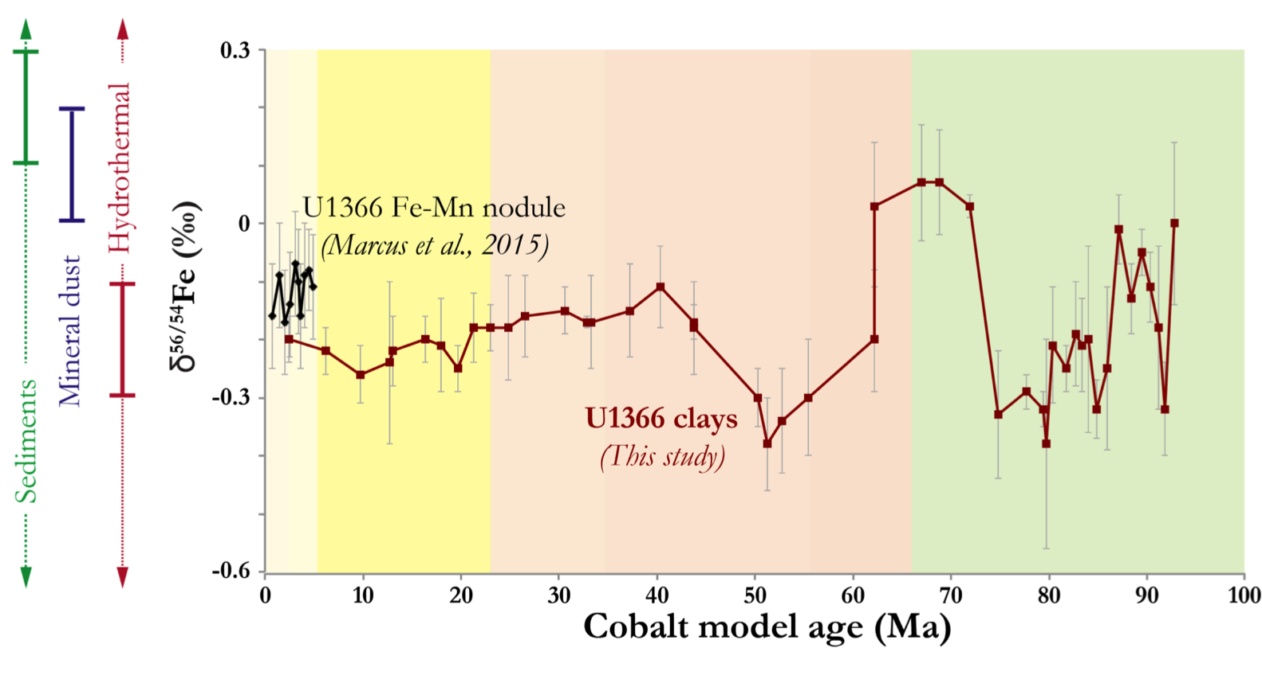
Fe Isotope Results
Miocene
Oligocene
Eocene
Paleocene
Late Cretacous
Dust
Component Mixing
Hydrothermal
Reducing Sediment
Notes:
And here are the Fe isotopic results!
On the x-axis we use the Co age model to estimate age. Like I mentioned, the Os age model isn’t quite ready to be used since we need more samples. But, once that model is created, we will use that
On the y-axis we have the Fe isotopic values and the end members of the three sources of Fe (hydrothermal, mineral, sediment)
The black data shows another study of a different sedimentary type (Fe-Mn nodule) that returns similar Fe isotopes to our data
We see 4 major changes over time. Although I don’t have enough data to make concrete statements about these areas, I do have a couple of hypotheses. Here, I’ve added what some of the sources may have been primarily comprised of. Again, these are all qualitative hyphteses.

Slide 8
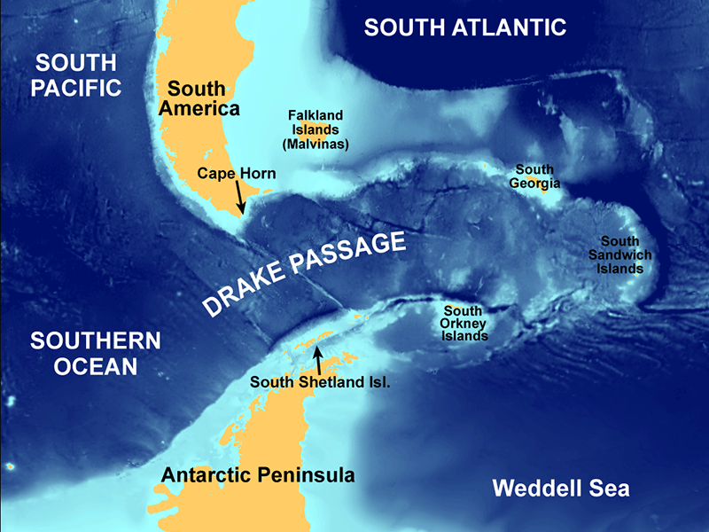
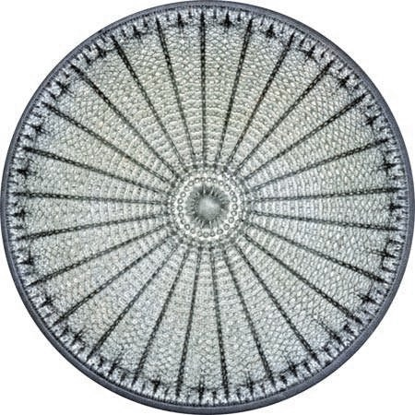
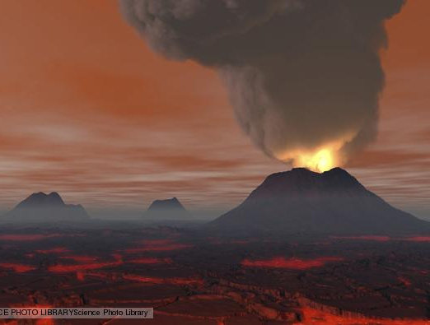
Conclusions and Outlook
Opening of the Drake Passage
The opening of the Drake passage (~41 Myr) may have changed ocean circulation and introduced more hydrothermal input
Diatoms
Diatoms became abundant ~34 Myr ago—how did this affect Fe?
Large Igneous Provinces (LIPS) and volcanic ash inputs
LIPS and/or volcanic ash may have increased dust input from 65-75 Myr
Notes:
My hypotheses may align with some events in the geological events
Talk about each of them
LIPS may be easy to see, because they could be recorded in the Os record
However, before taking any of these ideas and really diving in, there is a little more work to be done

Slide 9


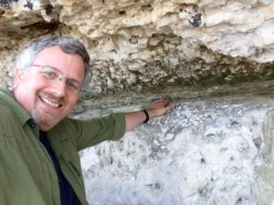






Acknowledgements
Ariel Anbar
Stephen Romaniello
Tristan Horner
Ann Dunlea
Wang Zheng
Maureen Auro
Alyssa Sherry

